Slide 1
The Stable
Marriage Problem (SMP)
Part I
and see accompanying handout

Slide 2
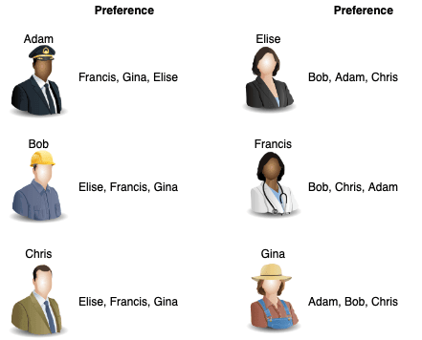
Problem statement
n men; n women
Each person has ranked all the members of the opposite sex.
Match each man with a woman so that there are no two people of opposite sex who would prefer each other to their current partner (such a pair is known as a blocking pair).
The resulting matching (set of matches) is called stable.
A matching with at least one blocking pair is called unstable.
Img src: https://www.arvarik.com/visiting-the-stable-marriage-problem
Notes:
e.g. of blocking pair – say matches included Bob & Gina and Adam & Francis (and Chris & Elise)
So Bob and Francis are not together, but each would prefer to be:
Bob prefers Francis to Gina
Francis prefers Bob to Adam.
So Bob and Francis are a blocking pair.

Slide 3
Example Applications
The SMP has been utilized for many different applications. Some examples include matching:
students with high schools in New York city
graduating medical students to their first hospital appointments in the U.S.
one person to another in dating apps
users to servers in a large, distributed Internet service
many others…

Slide 4
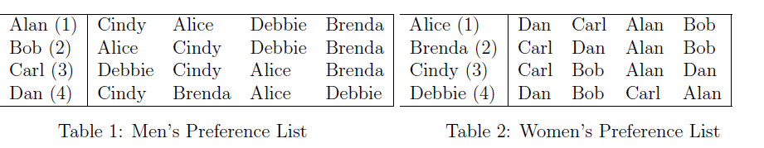
Examples
Let’s check out this example on the handout:
Let’s try to find:
a stable matching
an unstable matching
and a blocking pair

Slide 5
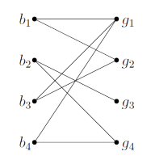
Side note: Graph representation
matchings arise in the context of bipartite graphs
bipartite graph
  the nodes are split into two sets and
  arcs only connect nodes in different sets, not nodes in the same set

Slide 6
Algorithms for Solving the SMP
Gale-Shapley Algorithm – see handout
Integer Programming
Constraint Programming (CP) – see Lustig & Puget reference, we will cover CP later in this course
Genetic Algorithms
many others especially for variants on the SMP
we may also want to write additional code to help with tasks such as:
  finding the ordered list of better choices for a person than their match
  checking we do not have a blocking pair in a matching

Slide 7
Some Properties of the Gale-Shapley Algorithm
the algorithm will terminate in a stable matching
the stable matching found is the one that is best for the proposers among all stable matchings, and worst for all recipients
we can have men propose or instead have women propose
  both result in stable matchings
  the resulting matchings (men-propose vs. women-propose) will not necessarily be the same
  all men-propose executions of the algorithm result in the same stable matching (analogous result for women-propose)
no person can do better by lying about their preference list
no group of proposers can misrepresent their preferences in a way that results in those proposers being better off than if they acted in their own interest independently
see the Gusfield & Irving reference for proofs of some of these

Slide 8
Coming up in Part II
IP formulation
python implementation
problem variations and implementation ideas
** GUEST LECTURE **

